Slide 1
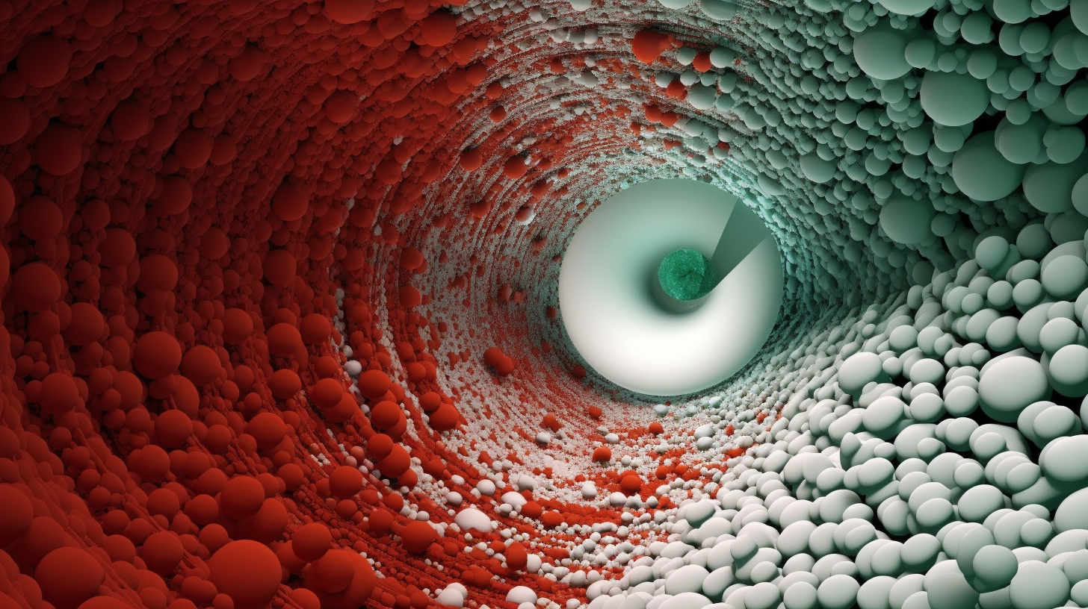


Using Deep Learning to find needles in a genomic junkyard
Panagiotis Alexiou, PhD
ERA Chair,
Bioinformatics for Genomics in Malta
(BioGeMT)

Slide 2



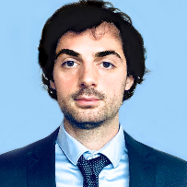
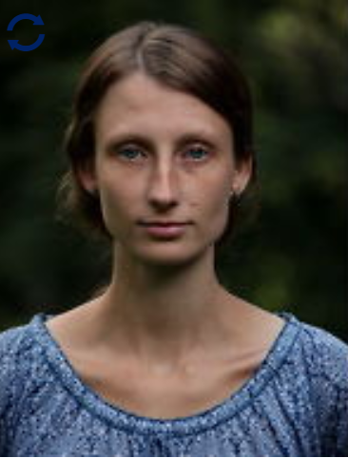

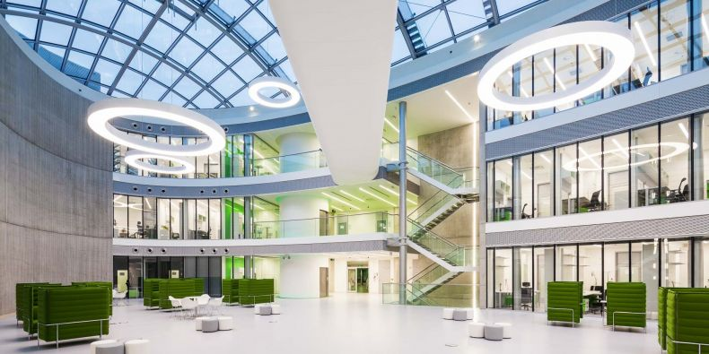
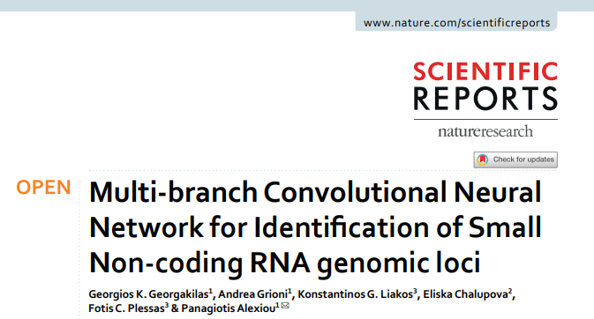
George
Georgakilas
Andrea
Grioni
Eliska
Chalupova
CEITEC – Masaryk University

Slide 3
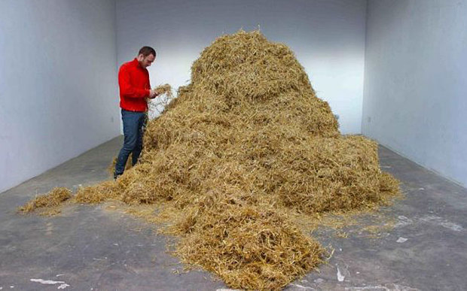
Finding a needle in a haystack: The brute force approach

Slide 4
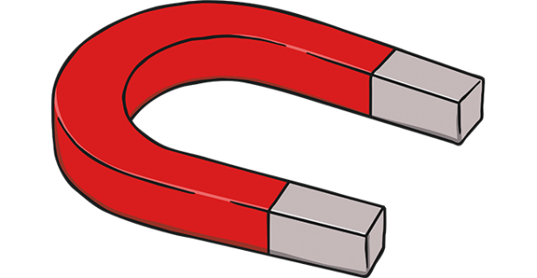
Finding a needle in a haystack: Characterize the Problem
There is 1 and only 1 needle in the haystack
The needle has specific determining characteristics
Material: Metal
Length: short

Slide 5
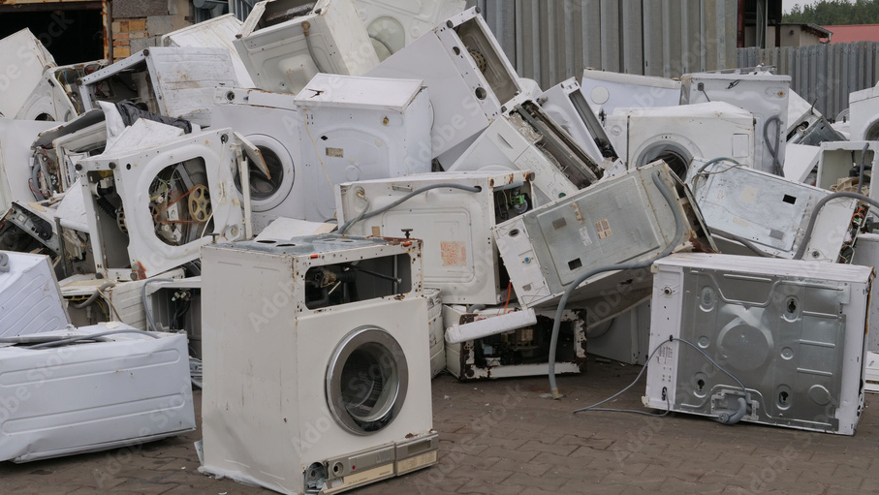
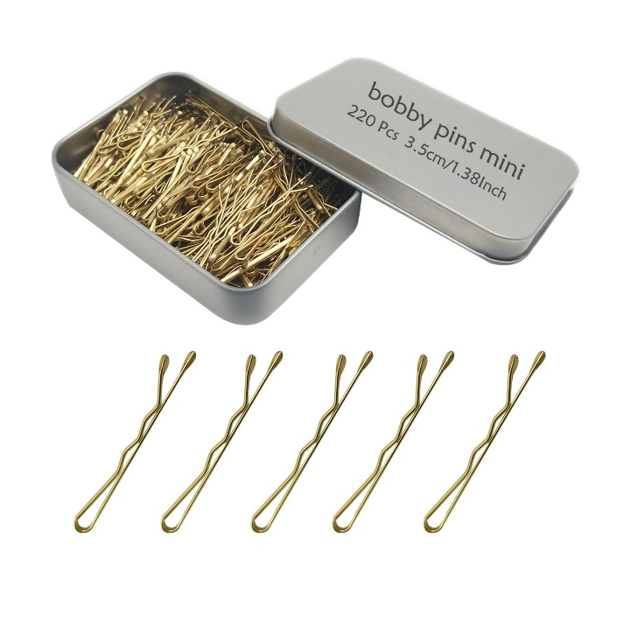
Finding a needle in a junk yard
There is an unknown number of hairpins in the junkyard
There are billions of items in the junkyard
The specific determining characteristics are not clear

Slide 6
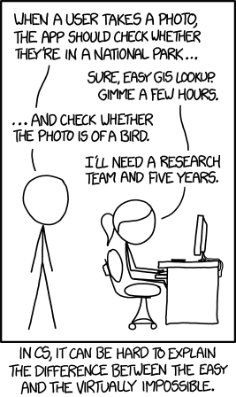
Finding a needle in a junk yard
There is an unknown number of hairpins in the junkyard
There are billions of items in the junkyard
The specific determining characteristics are not clear

Slide 7
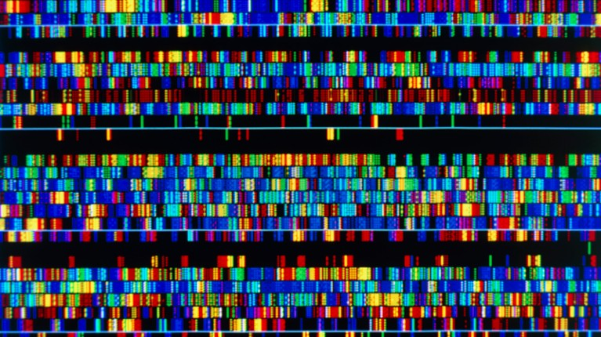
The Human Genome
(aka the Junk Yard)
Search Space
~ 6 Gbp
(in 2 orientations)
Accounted for
~5%
Backgrounds
Random Variation
Regulatory regions
Expressed RNAs
Repeat Elements
“Junk”
~95%

Slide 8
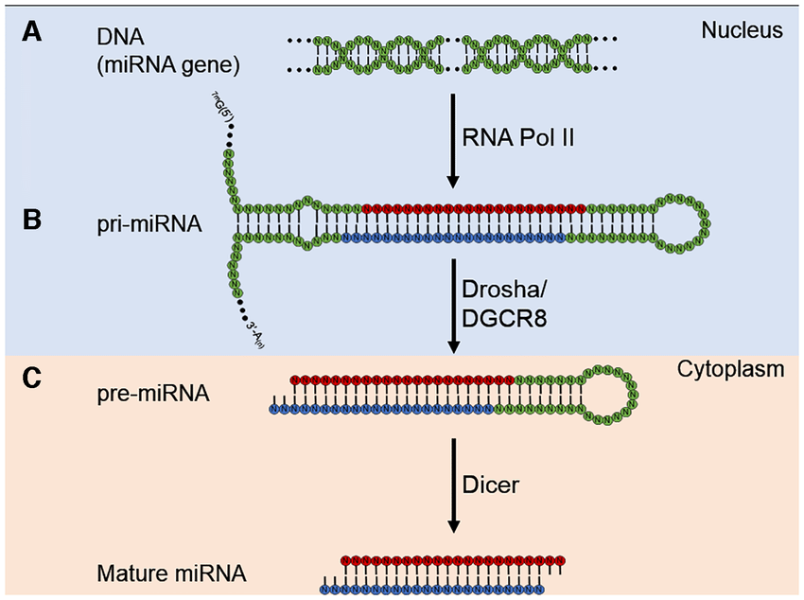
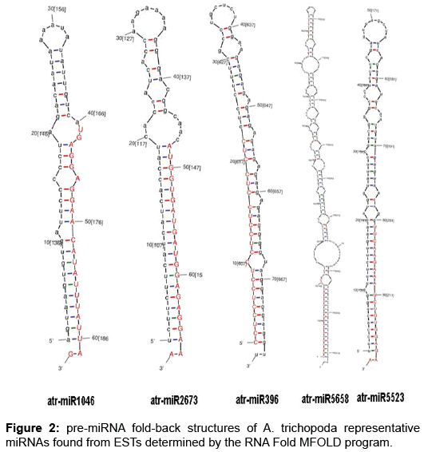
pre-miRNA
(aka the Hairpins)

Slide 9
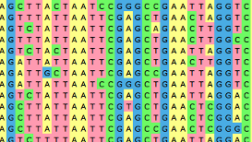
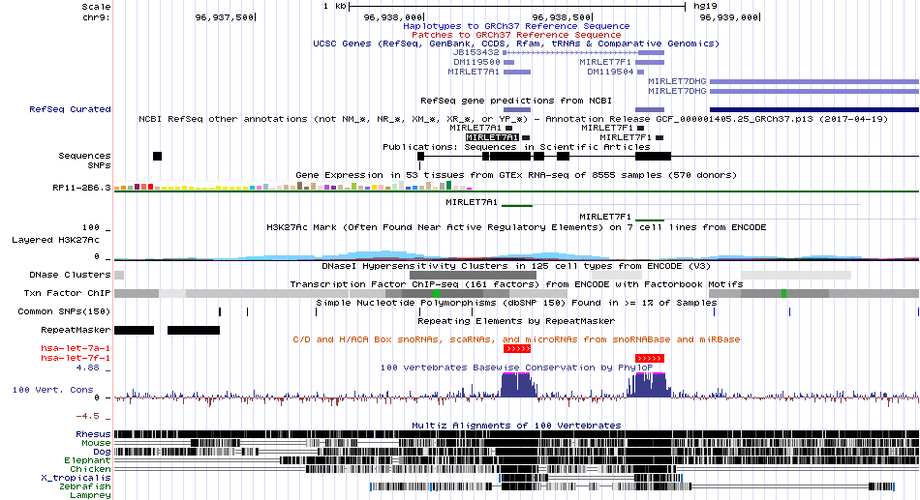
pre-miRNA genomic locus identification
Known hairpin structure
High conservation with distinct pattern
Some sequence preferences
Approx. 2000 known in human
=
Should be an easy task!?

Slide 10
Finding a needle in a junk yard
There is an unknown number of hairpins in the junkyard
There are billions of items in the junkyard
The specific determining characteristics are not clear
The Plan!
Step 1: Collect all known examples of hairpins
Step 2: Measure characteristics of hairpins
> length
> shape
> color
> etc
Step 3: Build a machine that can measure this for every given piece of junk
Step 4: Allow the machine to learn by example.
> Give the machine 1000 hairpins and 1000 junk
> Retrieve characteristics that define hairpins best
> Make rules to distinguish / classify
Step 5: Present prototype

Slide 11
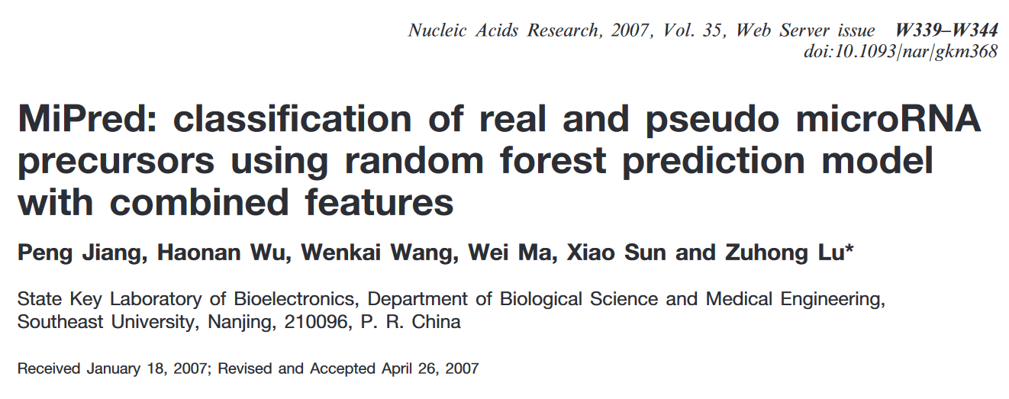
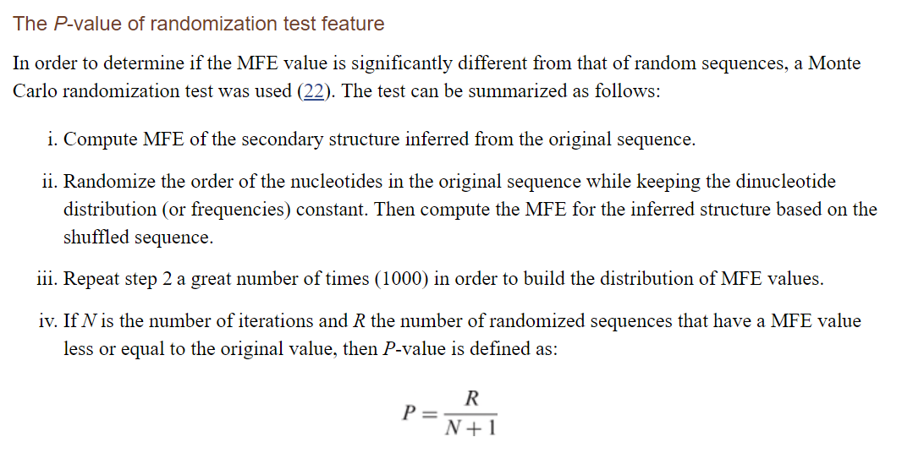
1:1
Real
Pre-miRNA
(miRBase)
Fake
Pre-miRNA
(bkground)
Measure
Features
Measure
Features
Compare Features & Build Model
Classify Real vs Fake

Slide 12
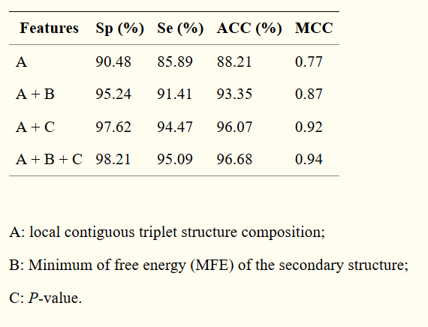
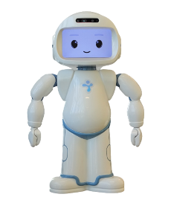
440 citations
Specificity: The proportion of observed negatives that were predicted to be negatives
Sensitivity: The proportion of all positives that were predicted to be positive
Hairpin
Box
Unknown
Box
(1:1 mix)
Junk
Box

Slide 13
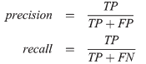
3000 hairpins of ~100bp each
3 billion nucleotides
--------
1 in 10,000 chance
Unknown box 1
(1:100 mix)
1,000 hairpins
vs
10,000 nucleotides around each hairpin
(~ 100 fakes)
Hairpin
Box
Unknown
Box
Junk
Box
Unknown box 2
(FP mix)
no hairpins
vs
An infinite stream of fakes
(pick until you falsely call a something a hairpin)
Precision: If I called it a hairpin, it sure is a hairpin…
Sensitivity (recall): If it is a hairpin, I will sure call it one…

Slide 14

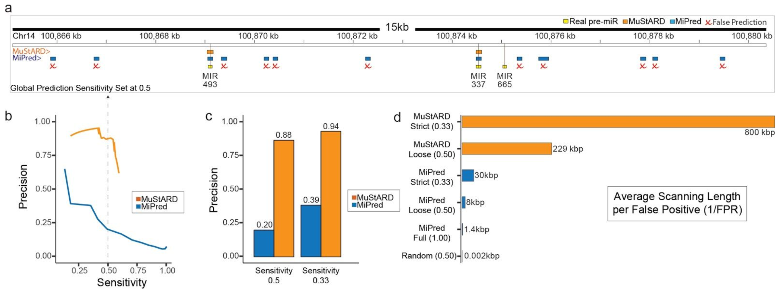
Hairpin
Box
1:1
Unknown
Box 1
(1:100)
440 citations
Junk
Box
Unknown
Box 2

Slide 15

simple
building
blocks
neurons
increasingly
complicated
architectures

Slide 16
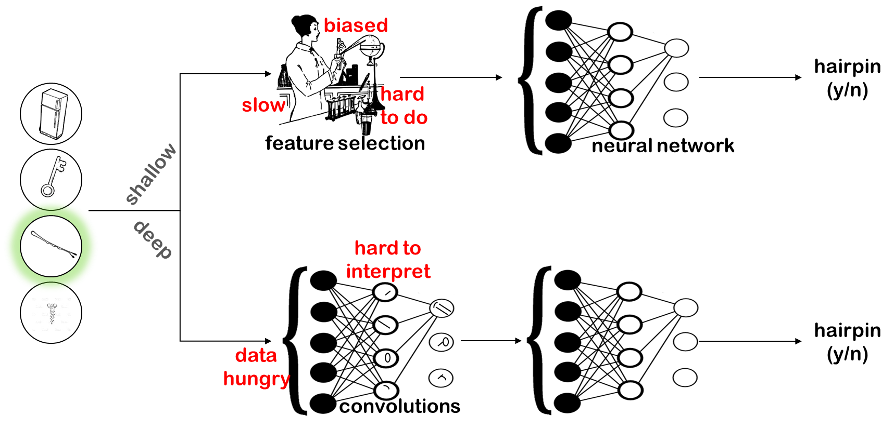

Slide 17
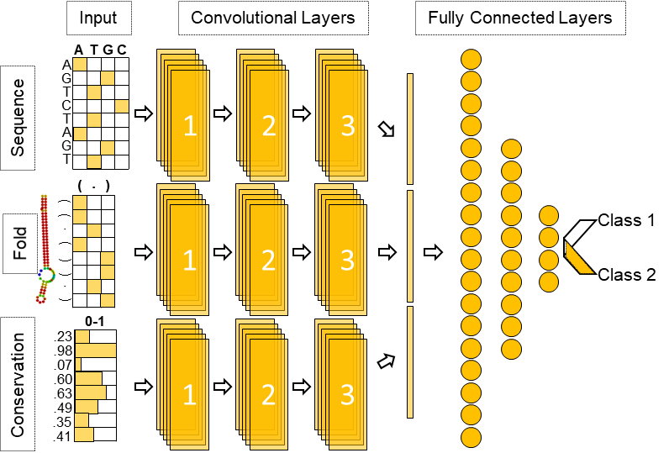

G. Georgakilas
A. Grioni
E. Chalupova

Slide 18
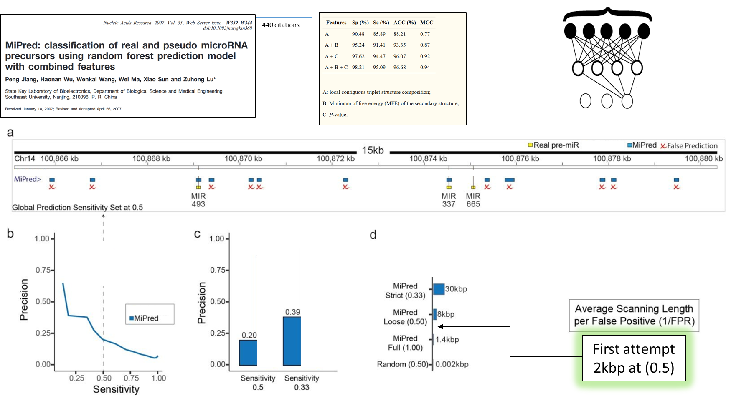

Unknown
Box 2

Slide 19
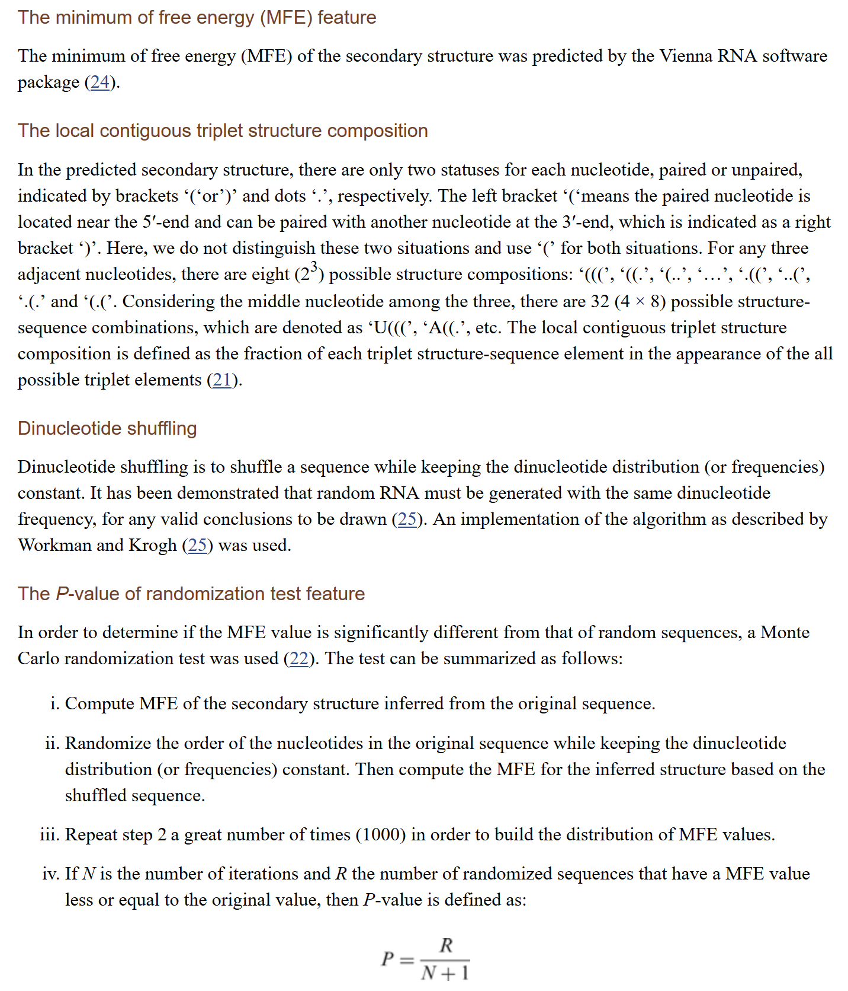
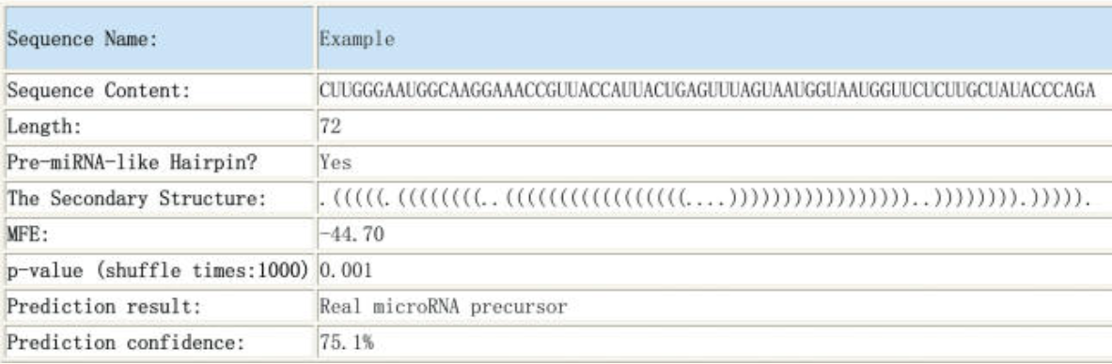
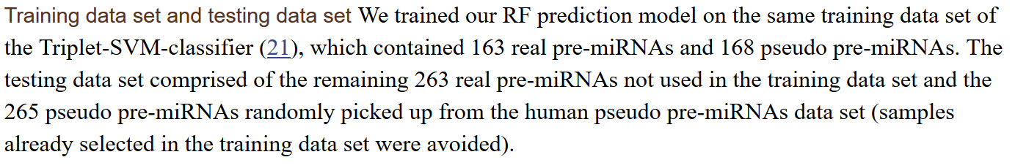
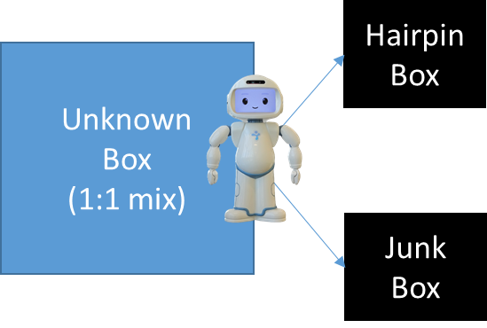
440 citations
1:1 Ratio

Slide 20
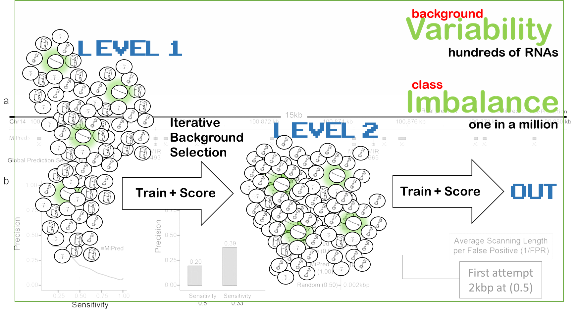

DOES THAT LOOK LIKE
A HAIRPIN AT ALL?
DOES THAT HAIRPIN LOOK LIKE A PRE-MIRNA?

Slide 21
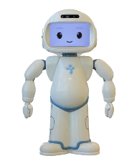
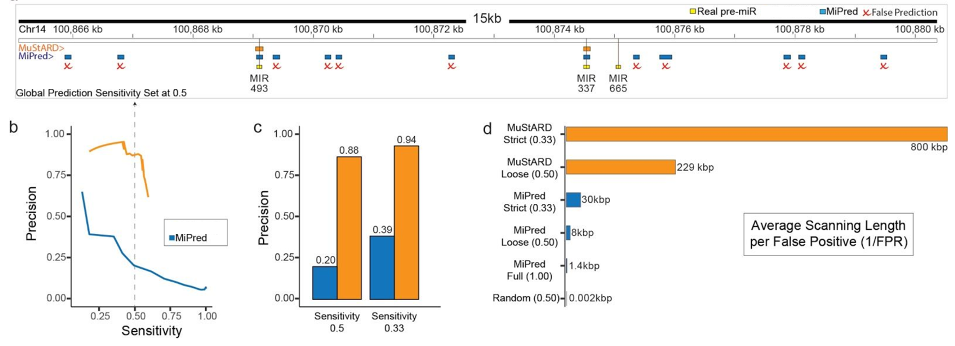
We are still not able to predict
at the genome wide level.
(Loose 1/FPR: 2000 kbp) (Strict 1/FPR: 3000 kbp)
Hairpin
Box
Unknown
Box 1
(1:100)
Junk
Box
Unknown
Box 2

Slide 22

Predicting Mouse pre-miRNAs using a human trained model

Slide 23
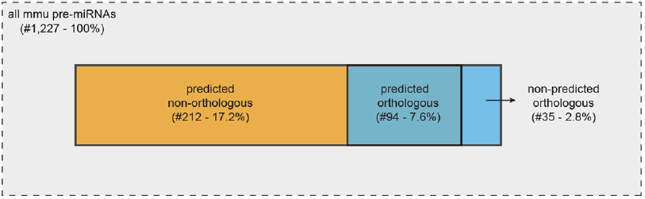
Predicting Mouse pre-miRNAs using a human trained model

Slide 24
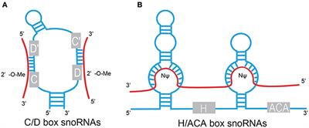
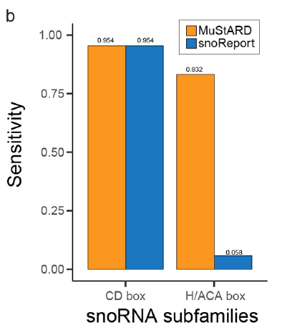

Slide 25
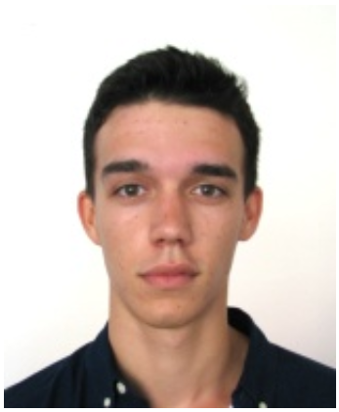
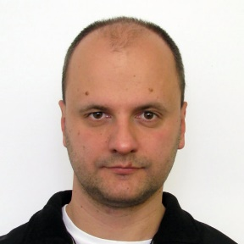
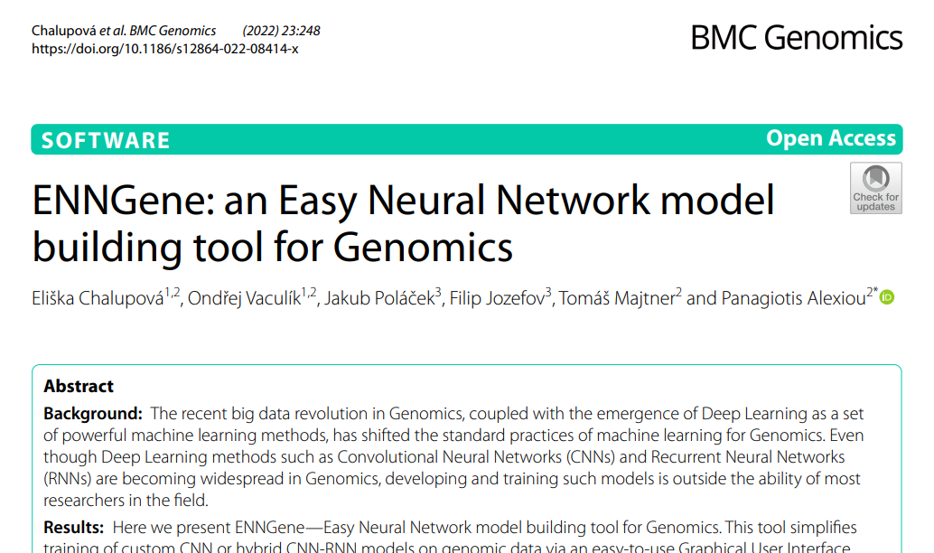
Eliska
Chalupova
Ondrej
Vaculik
Tomas
Majtner
CEITEC – Masaryk University

Slide 26
1
Preprocessing
Positives
Background
Background
Background
Make it as easy as possible for a non-expert to get their dataset ready
Input: BED file of Positive loci
Reference files: Sequence, Folding, Evolutionary Conservation
Preprocessing module takes input file and automates extraction of training dataset
Can be controlled via GUI

Slide 27
2
Training
Positives
Background
Trained
Model
Neural Network
Make it as easy as possible for a non-expert to build and test deep learning architectures
Convolutional Layers
LSTM Layers
Fully Connected Layers
Multiple Branches possible
Everything can be controlled via GUI or config file

Slide 28
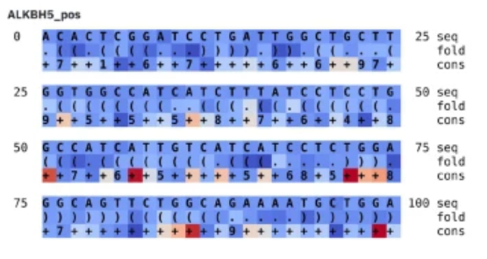
3
Prediction
Positives
Trained
Model
?
OR
Background
Make it as easy as possible for a non-expert to (i) evaluate models (ii) predict on new data
Returns scores per input
Returns metrics (precision, recall etc)
Can be used with .fasta files if only sequence model
Interpretation of model learning via Integrated Gradients
Everything can be controlled via GUI or config file

Slide 29
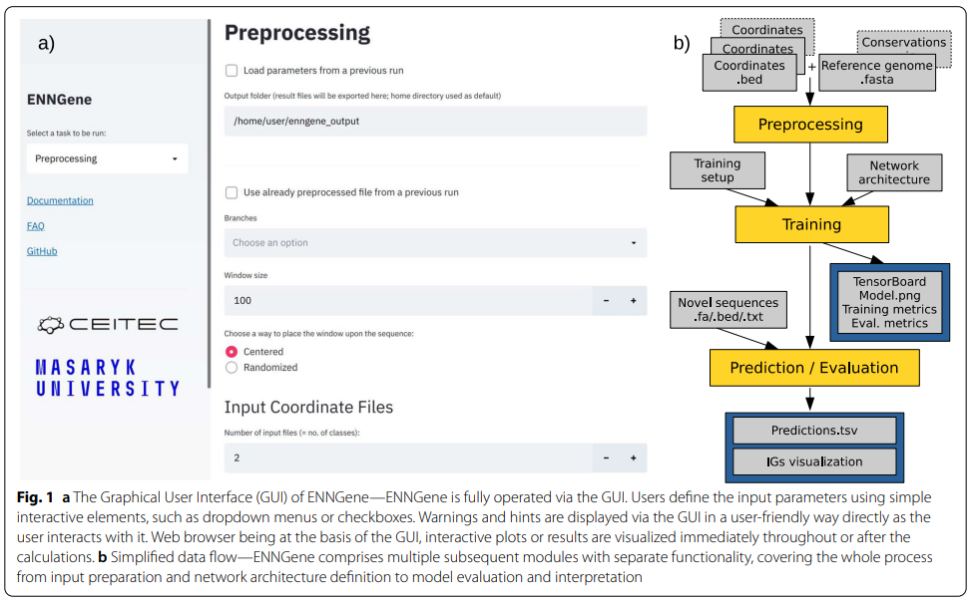
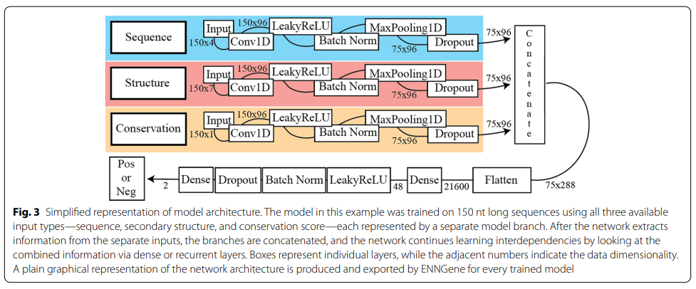
ENNGene
https://github.com/ML-Bioinfo-CEITEC/ENNGene
RBP

Slide 30
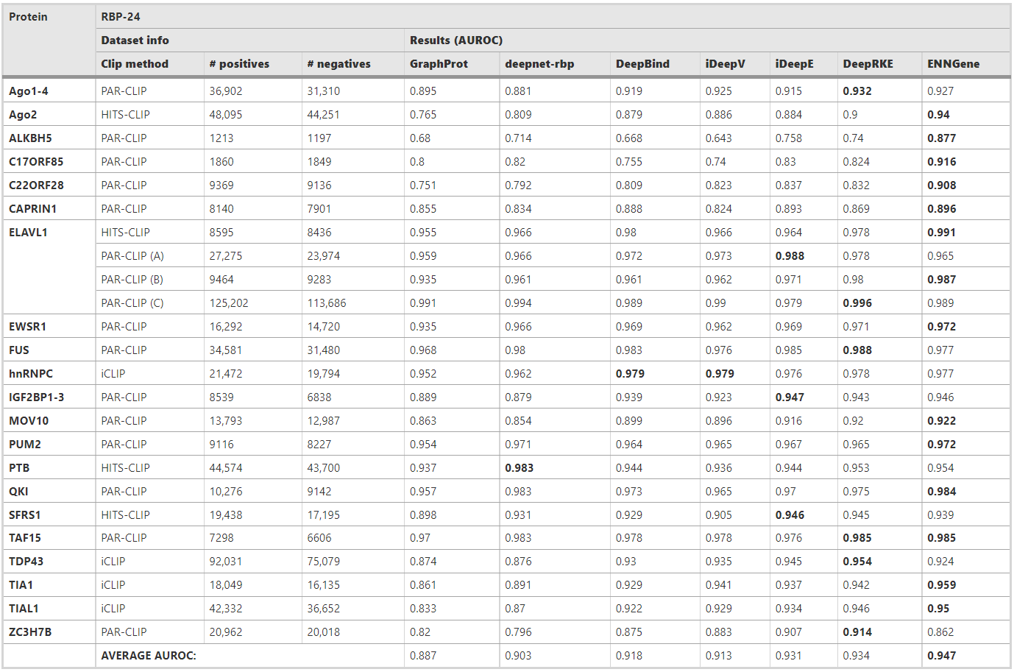

Slide 31
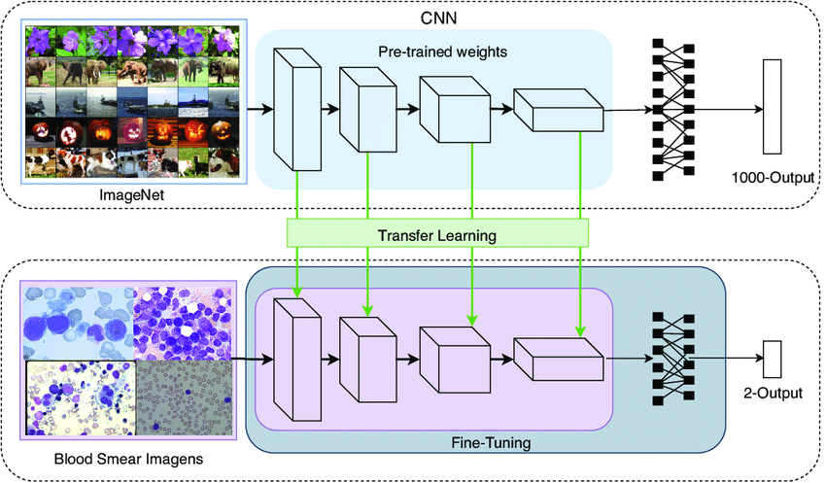
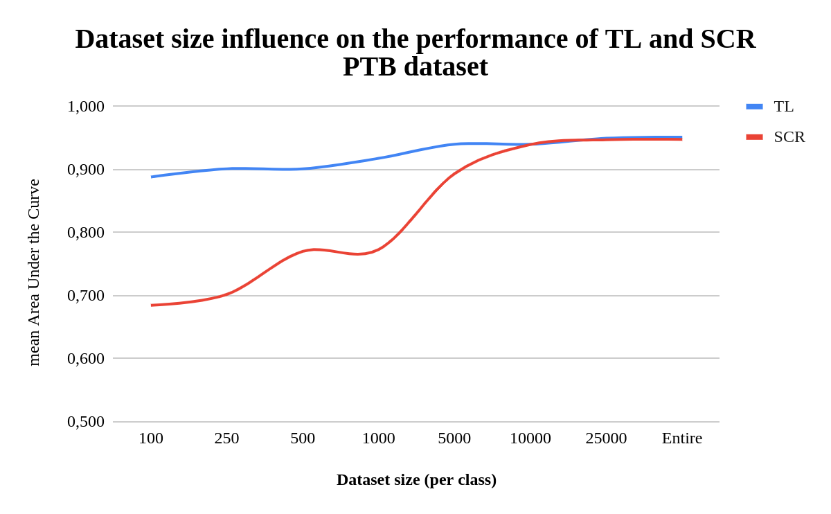
RNA Binding Proteins – Low N of samples
*under review
E Chalupova
O Vaculik
RBP

Slide 32

The Future…
- Combination of larger architectures, transformers, language models.

Slide 33
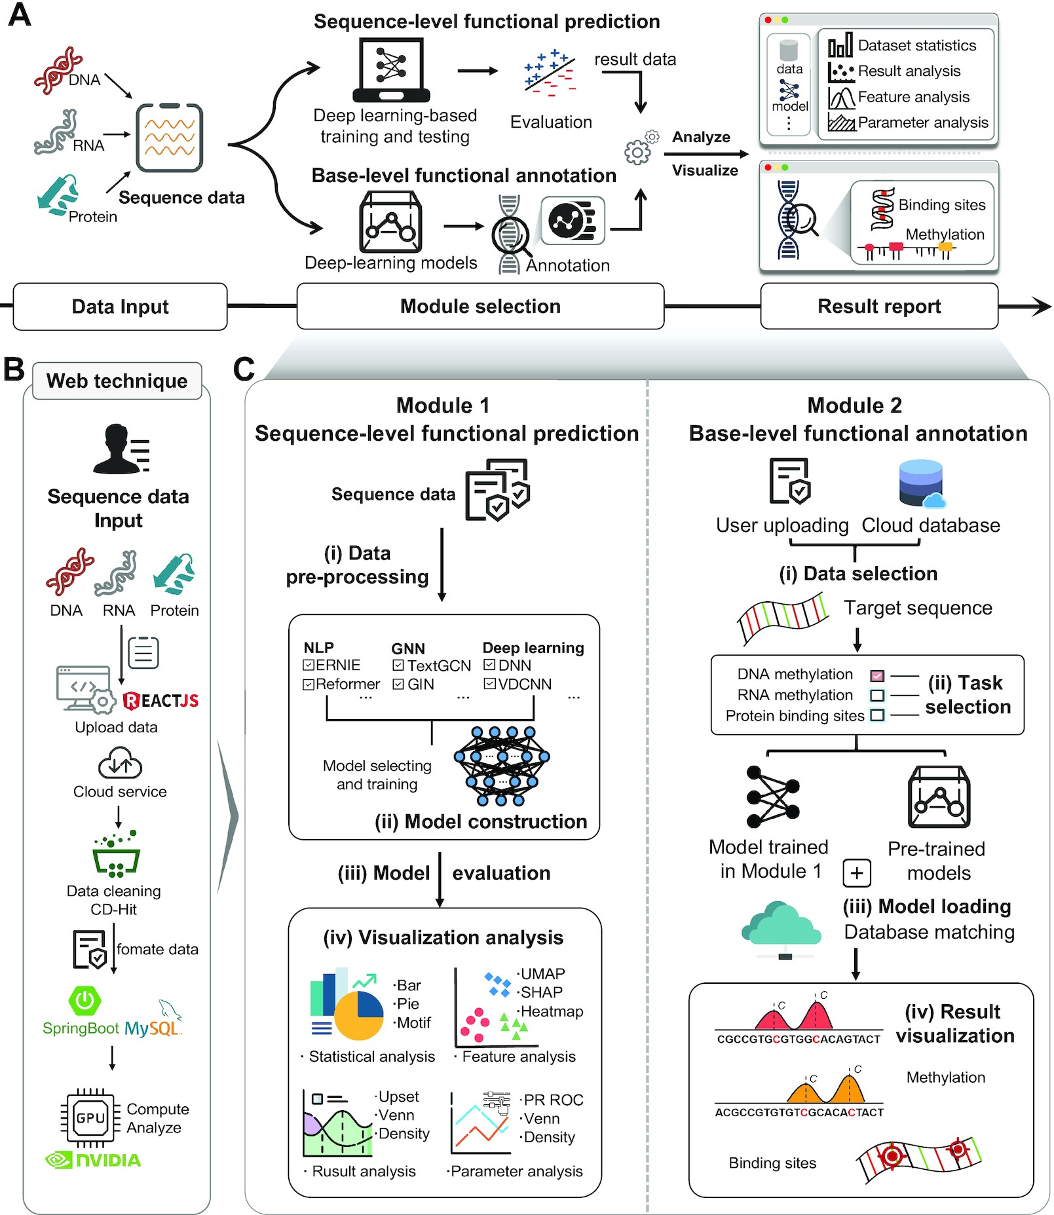
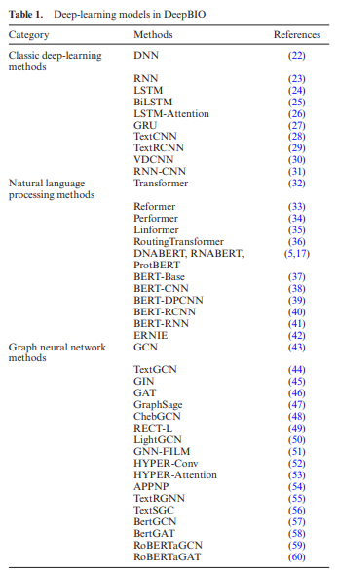
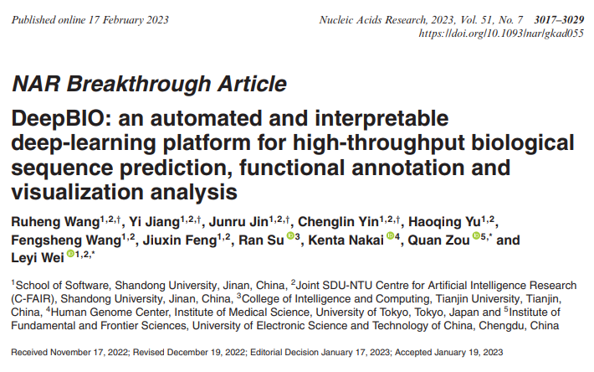
2023

Slide 34
The Future…
Combination of larger architectures, transformers, language models.
Foundation models for genomics.

Slide 35
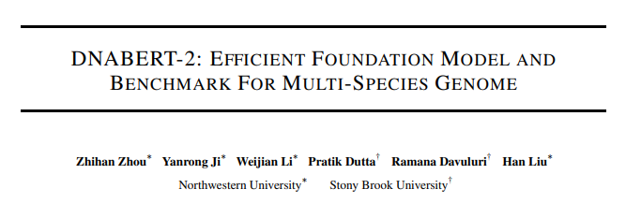
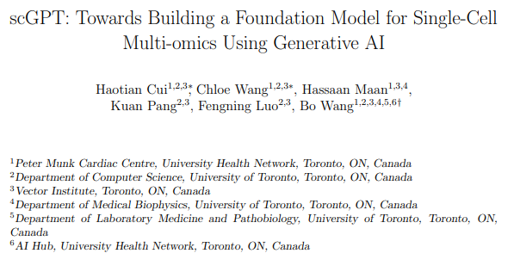
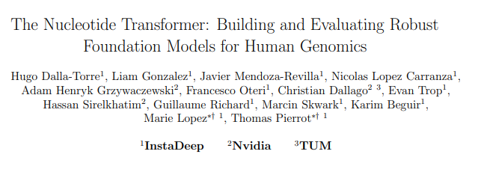
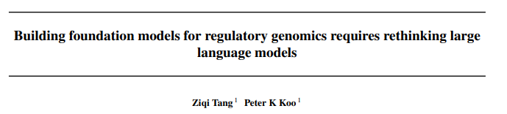


Foundation
Models
2023

Slide 36
The Future…
Combination of larger architectures, transformers, language models.
Foundation models for genomics.
Large Language Model integration of data from different modalities

Slide 37






Multi-Omic Data
Integration
2023

Slide 38
The Future…
Combination of larger architectures, transformers, language models.
Foundation models for genomics.
Large Language Model integration of data from different modalities
Explainability of ML models

Slide 39

The Future…
Combination of larger architectures, transformers, language models.
Foundation models for genomics.
Large Language Model integration of data from different modalities
Explainability of ML models

Slide 40



